Slide 1
Stock management system for mess
Presented by:
1.Gayatri Babruvan Bhore
2.Nivedita Vishwanath Birajdar
3.Vaishnavi Mallinath Birajdar
4.Priti Shivshankar Patil
Under guidance of : Ajita Patil Ma’am

Slide 2
Content:
Objective
Motivation
Project Scope
Problem Statement
System Architecture
Features
Hardware/Software Requirements
Project Flow
Future scope
Conclusion
References

Slide 3
Objective:
To maintain the availability of materials whenever and wherever required in enough quantity.
To maintain the Current stock details in mess.
To get the current stock updated notifications to mess manager and mess co-ordinator.

Slide 4
Motivation:
We went regularly to our mess, we have seen their manual work and understood the working scheme of mess .
Then we decided to make a stand alone application to reduce manual work and we can also manage mess in online mode.

Slide 5
Project Scope:
Our project aims at mess management process automation, i.e. we have tried to computerize various processes of Mess Management System.
We provide the focus on automatically stock updation .
Too easy to understand by the manager and co-ordinator of mess.
Too easy to operate.

Slide 6
Problem Statement
When we visited our mess we observed that every activity in our mess is done manually.
Because of this manual work our mess manager used to go in the mess and get the current stock details.
So that we have decided to make a standalone application for reducing this manual work .

Slide 7
Proposed System
In the proposed system mess manager can create new account and if manager forgot password then he can reset it by using forgot password frame.
Manager can also get the student , worker ,supplier details and print there report .
He can also calculate sallary of workers and print there sallary slips.
Mess co-ordinator will get notification of current stock details by using gmail.
Mess manager can order the stock according to their respective suppliers.

Slide 8
System Architecture:
Forgot
pass word
Log in
Create account
welcome
Menu page
Login
student
worker
supplier
stock
about

Slide 9
Features:
Mess Management System allows you to manage stock , calculate worker sallary easily.
In our stand alone application manager has all the privileges like adding, updating, deleting details of students ,workers, suppliers ,products.
In our stand alone application get the current stock updated notifications to mess manager and mess co-ordinator.

Slide 10
Hardware/Software Requirements:
Software requirements :
Installed Memory (RAM) – at least 350 MB
System type-64 bit Operating System;
Resolution-1366/768;
Hardware Requirements :
XAMPP Software installs on a standard PC system. Minimum Hardware requirements are as follows:
Processor –Intel(R) Core (TM)i3- 6006U CPU @2.00GHz

Slide 11
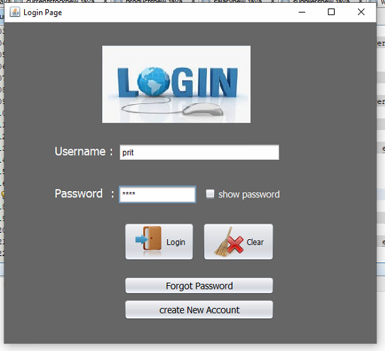
Project Flow: 1) Log in:

Slide 12
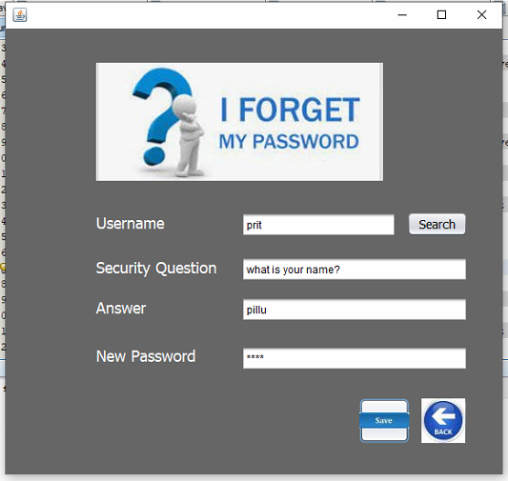
2) Forgot password

Slide 13
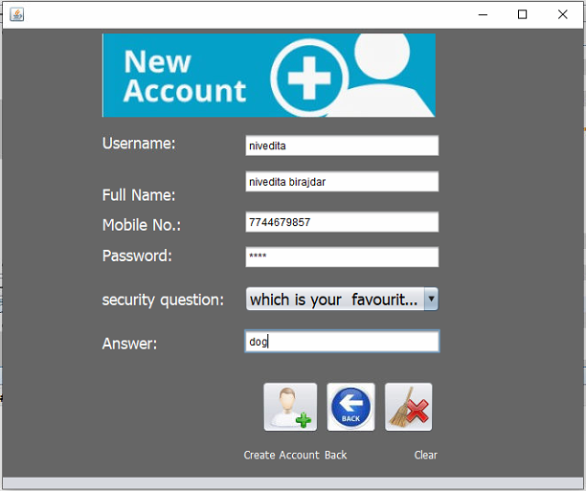
3) Create new account

Slide 14
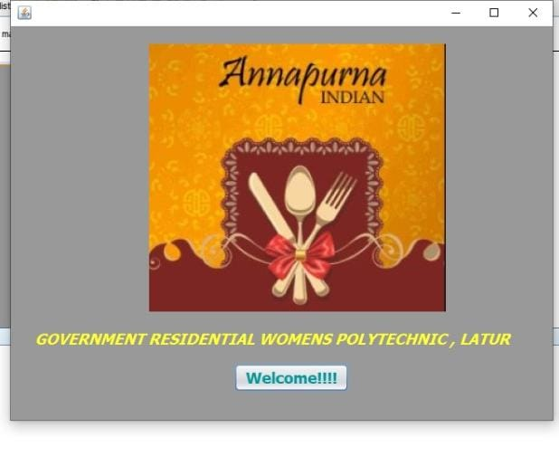
4) Welcome page

Slide 15
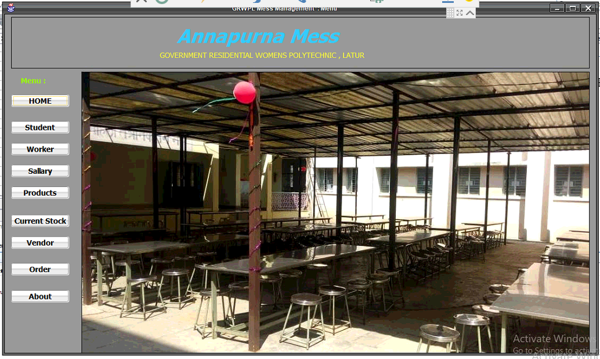
5) Menu page

Slide 16
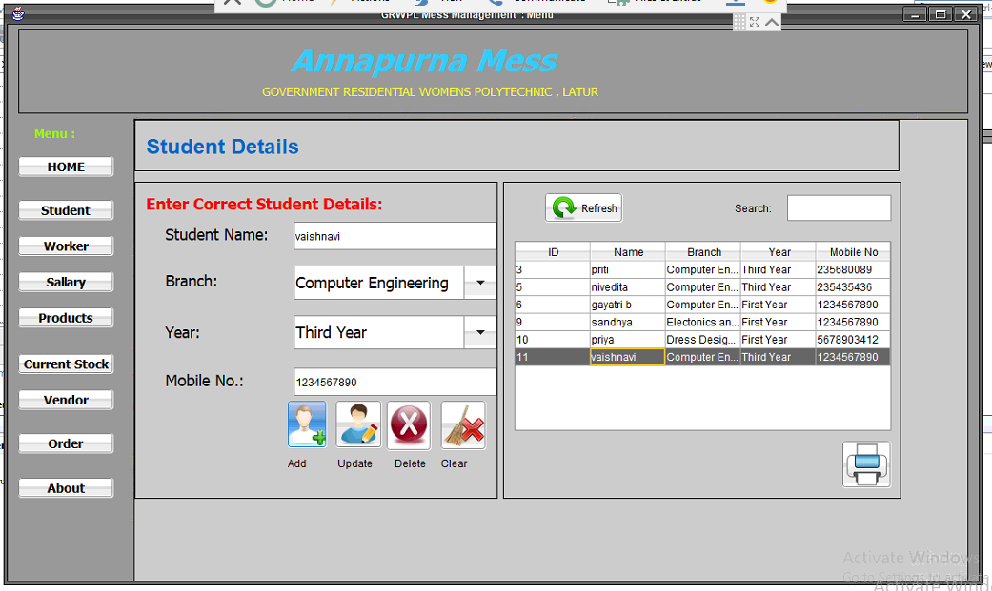
6) Student

Slide 17
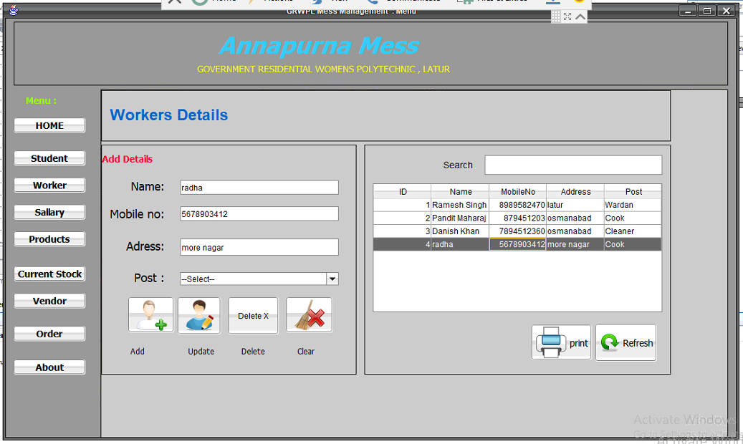
7) worker

Slide 18
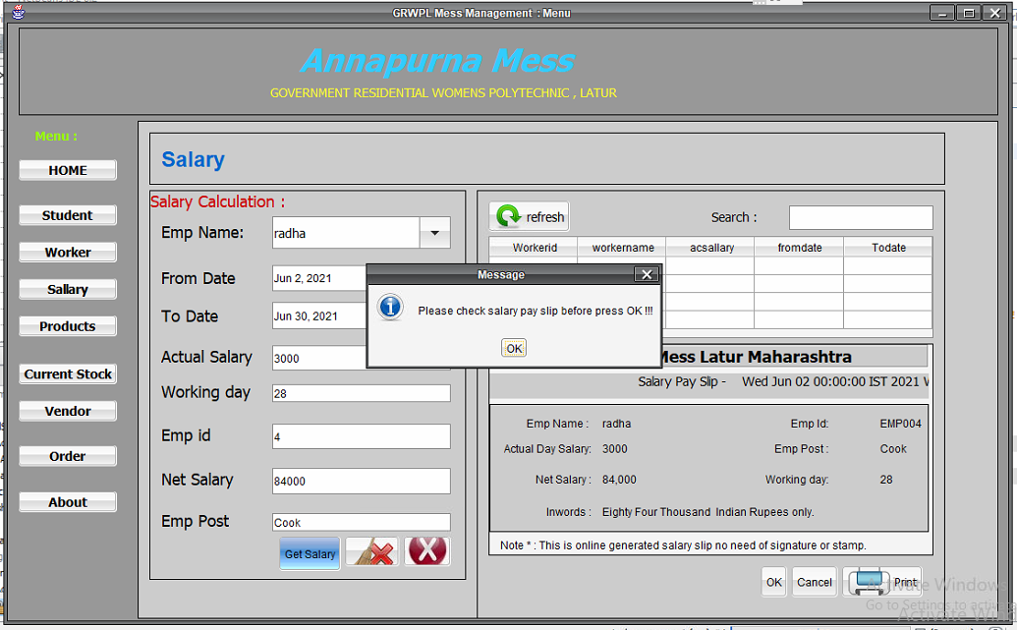
8) sallary

Slide 19
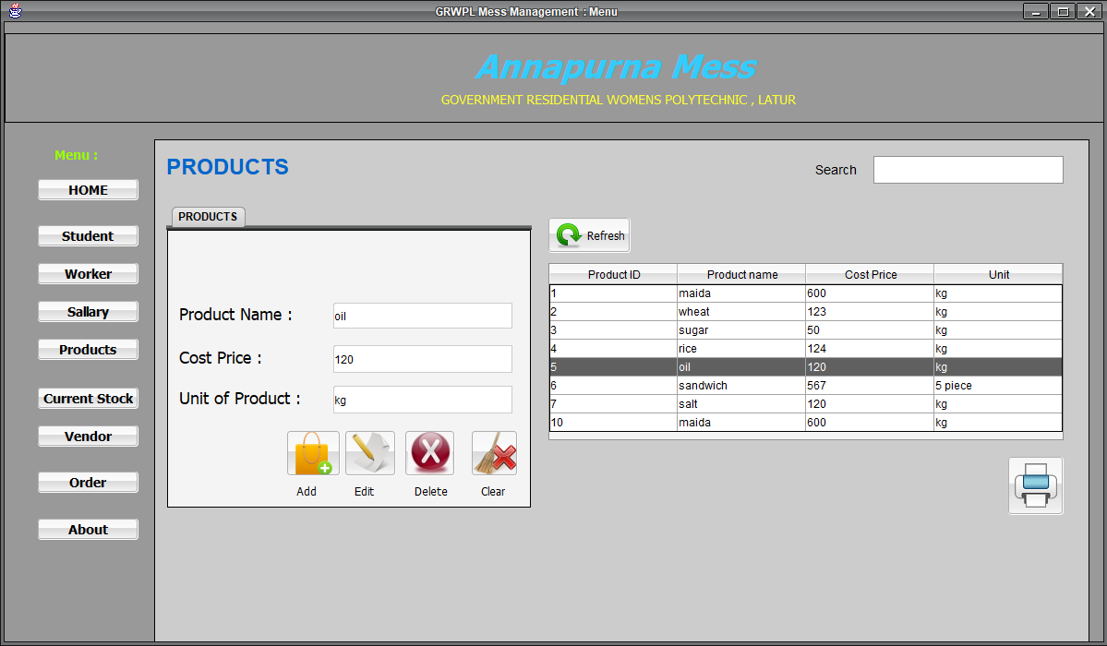
9) products

Slide 20
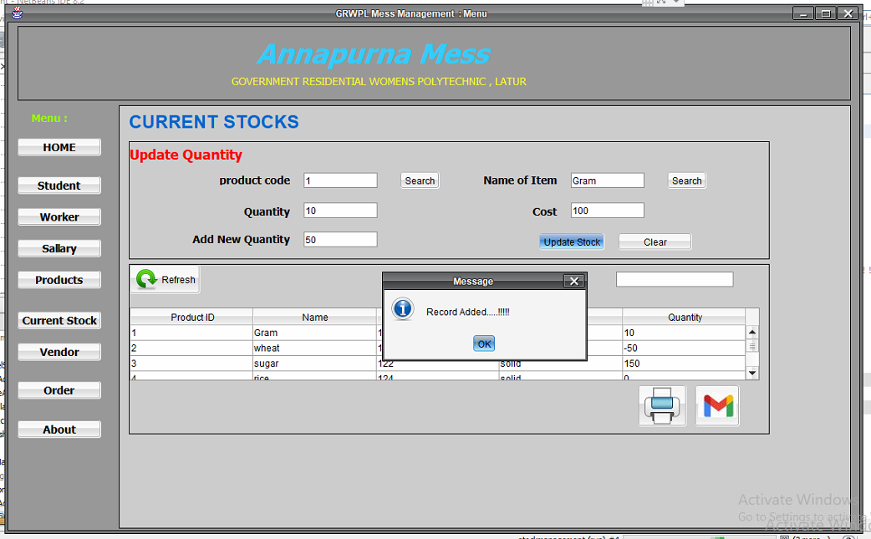
10) Current stock

Slide 21
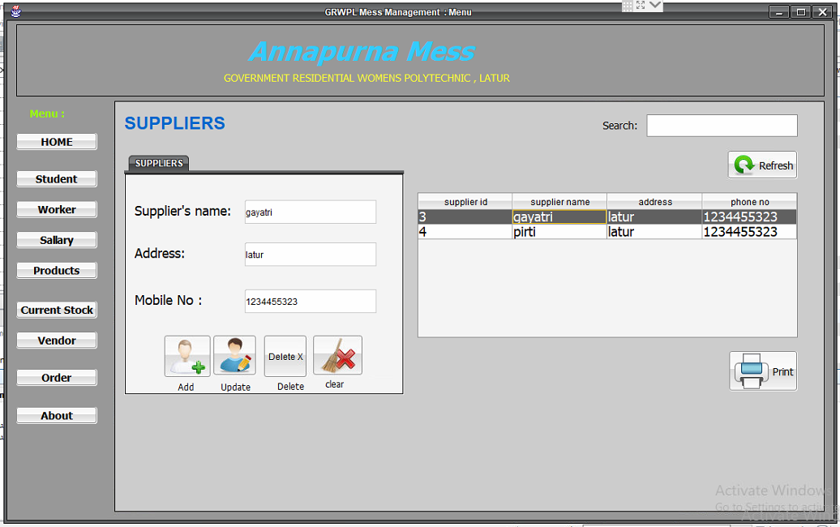
11) vendor

Slide 22
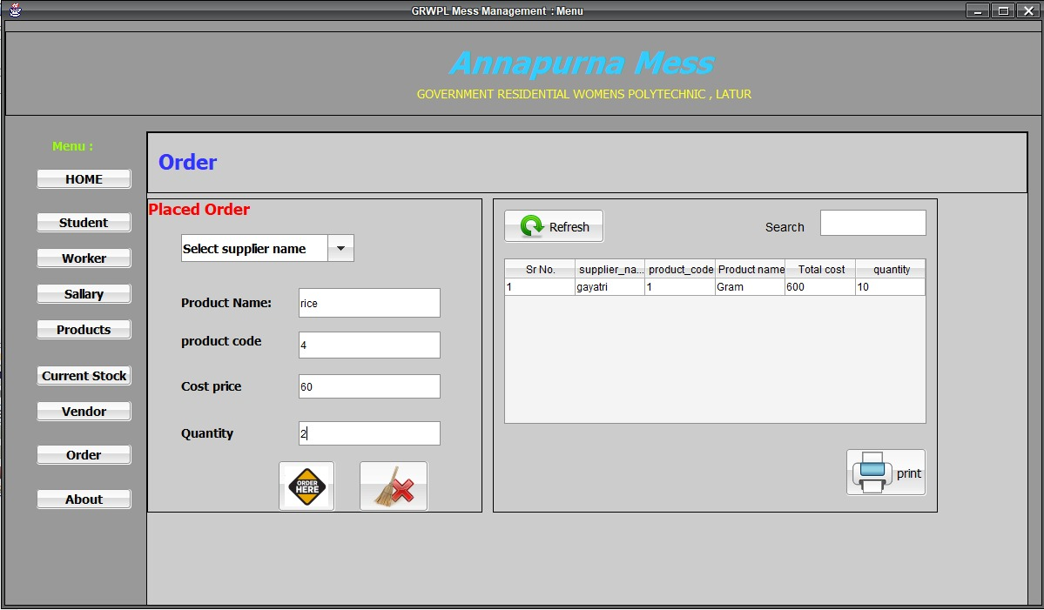
12) order

Slide 23
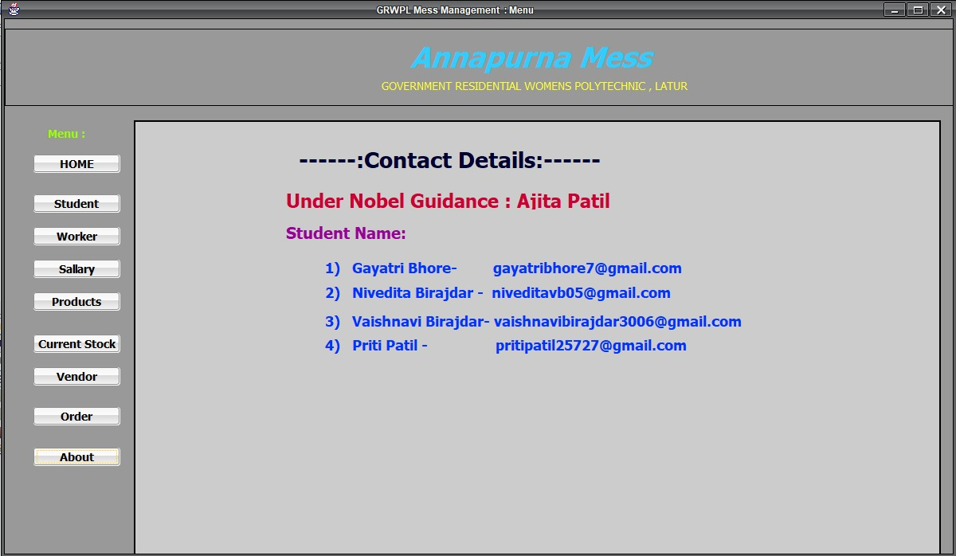
13) About

Slide 24
Future Scope
We hope that we can add student and worker attendance using biometric.
Students will be able to pay their mess fess using online transaction such as PhonePe ,GooglePe,etc .
We wish to add some more attractive GUI in future to make it more interactive for user.

Slide 25
Conclusion:
This stand-alone application will be useful to any school/college hostel or in general to any institute maintaining mess .
Security is maintained as the complete control of the system is only under the hands of an authorized person i.e mess manager.
This system will enable stock purchasing based on supplier name.
Since easy calculations and salary slip generations are done in a minute therefore it will reduce the workload of mess managers. Also this software will reduce manpower .

Slide 26
References:
https://prezi.com/nkcfv7tniqa_/hostel-mess- management- system/
https://code-projects.org/stock-management- system-in-javaa- andjavafx-using-NetBeans-with-source-code/
https://codeguid.com/2019/10/11/stock-management-system-project-in-java-with-source-code/

Slide 27
Thank You!

